Slide 1
Cpp development
Lecture 6

Slide 2
Schedule
Dynamic memory allocation
Smart pointers
Lists
Set and Map
Vector
Templates

Slide 3
Dynamic Memory Allocation

Slide 4
Stack vs Heap
Stack – fast memory using FILO sorted order to collect data
Heap – fast memory used with tree based structure. The data is not ordered.

Slide 5
Static memory allocation
Data goes in the stack.
The memory is deallocated when the data goes out of scope.
Good for short life variables.

Slide 6
Demo

Slide 7
Dynamic memory allocation
Data goes into the heap.
We use pointers to point and use objects
Good for long life or dynamically changing objects

Slide 8
Dynamic Memory allocation
Class *anObject = new Class();
Delete anObject;

Slide 9
Demo

Slide 10
Pros and cons

Slide 11
Memory leak
When we forget do deallocate an object
Slowing performance
May run out of memory

Slide 12
Smart pointers

Slide 13
Reference counting
A simple counter that contain number of current uses of an object

Slide 14
Smart pointer
In order to create dynamically allocated objects and then don’t give a damn about the memory allocation you can use smart pointers

Slide 15
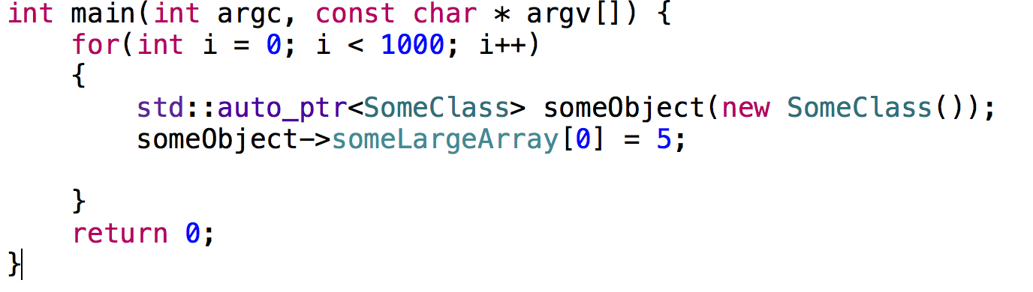
Implementation

Slide 16
Smart pointer types
Unique
Shared
Strong
Weak

Slide 17
Ok! Let’s code!

Slide 18
Questions

Slide 19
Task
Develop a game with the following gameplay:
A man is at Mars
His task is to collect 3 types of minerals.
The third type of mineral is very slippery, so a Man cannot hold it with hand (use weak pointer) without losing it.
The minerals initially are in 3 bags for each different mineral type. The man should find a way to transfer all the minerals from the bags to a cart.

Slide 20
Lists

Slide 21
Lists
The lists are allocating dynamically memory for items.
In order to reach certain element you should search it.
Item 0
Item 1
Item 2
Item 3

Slide 22
Initialization

Slide 23
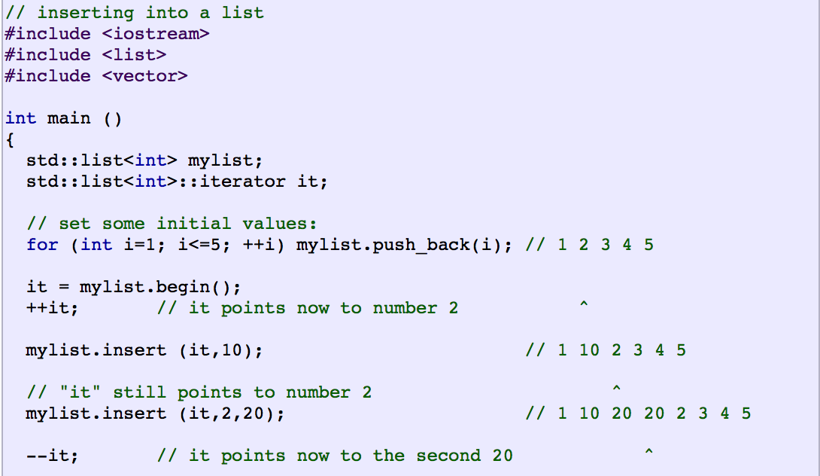
Add elements

Slide 24
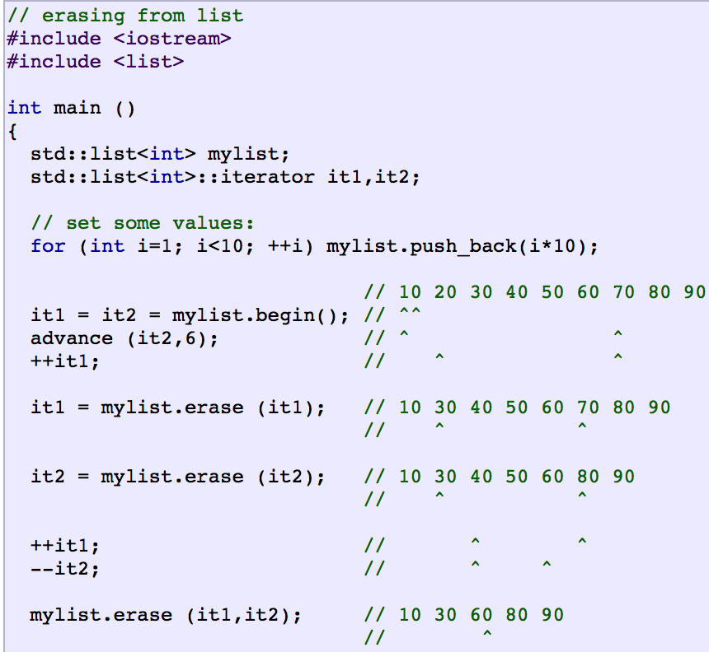
Remove elements

Slide 25
Task
Make a shopping list application.

Slide 26
Set
A list of unique items.

Slide 27
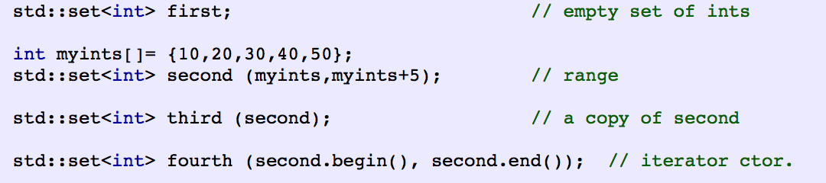
Initialization

Slide 28
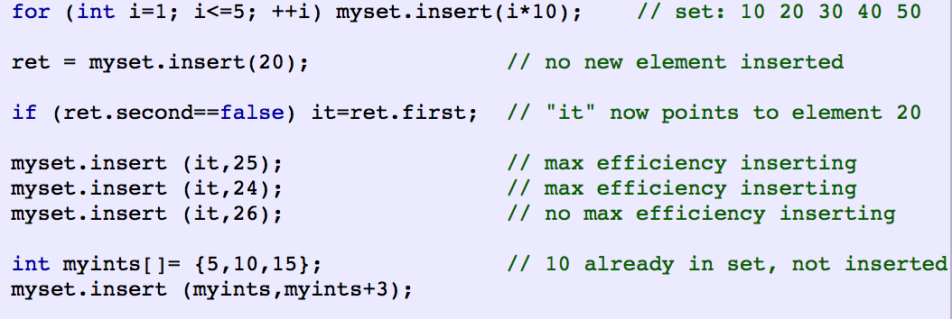
Insert

Slide 29
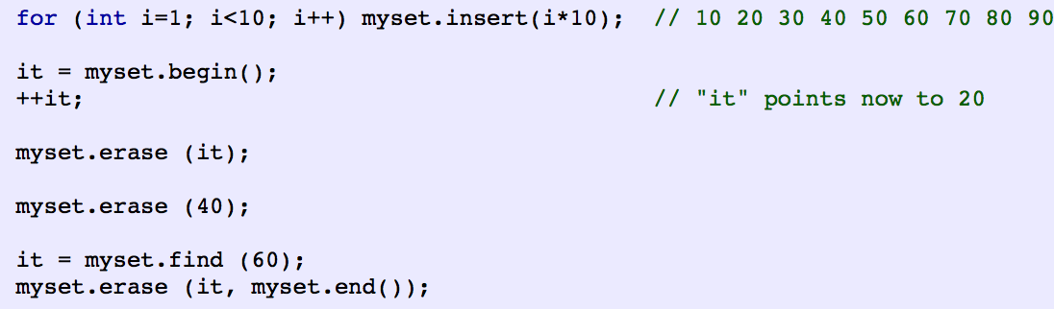
Remove

Slide 30
Map
[key:value]
Known as dictionary
Each value is assigned to key, not to index.

Slide 31
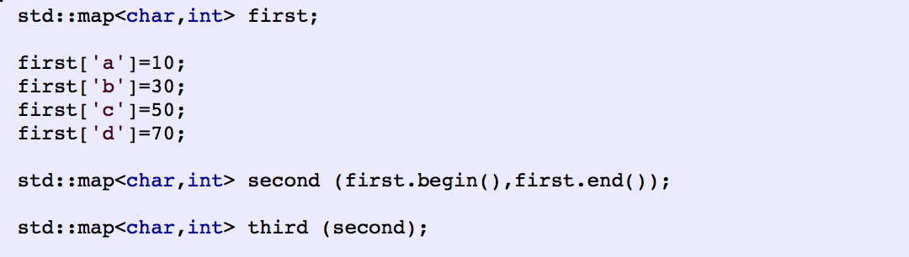
Initialization

Slide 32
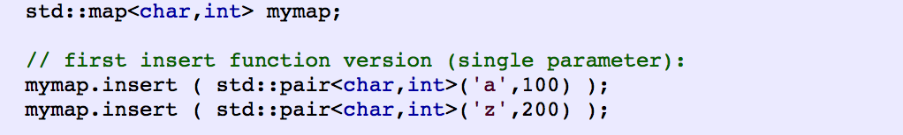
Insert

Slide 33
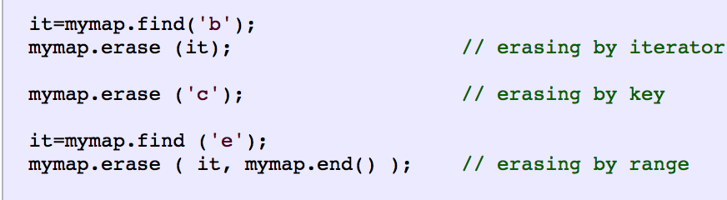
Erase

Slide 34
Task
Brexit
2 possible answers – LEAVE (defined as 0) and STAY(defined as 1)
Make statistics for people on different ages and their votes

Slide 35
Vector
Other name - mutable array
Array with dynamic memory allocation

Slide 36
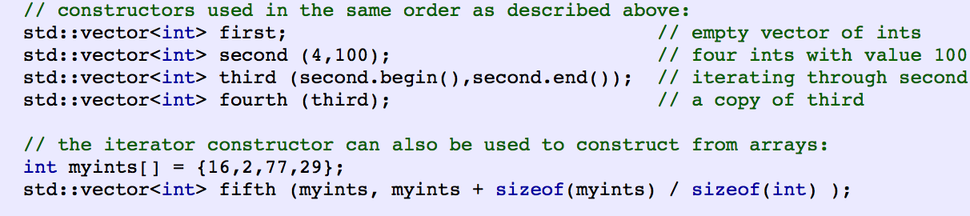
Initialization

Slide 37
Accessing elements
[];
At();
front();
Back();

Slide 38
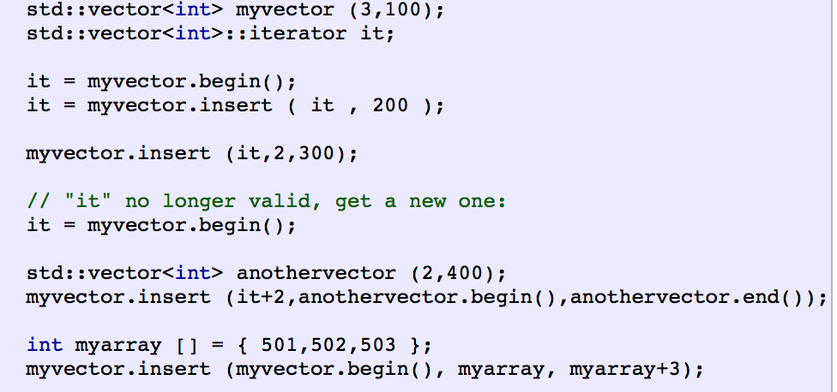
Insert

Slide 39
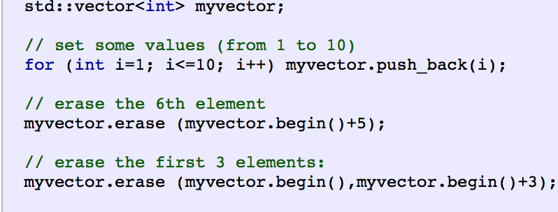
Erase

Slide 40
Task
You have to write a program that counts the people inside an office and gives information about their id numbers.
When someone leaves the office his id number is removed from the vector, when someone enters the office his id number is added to the vector.

